Slide 1
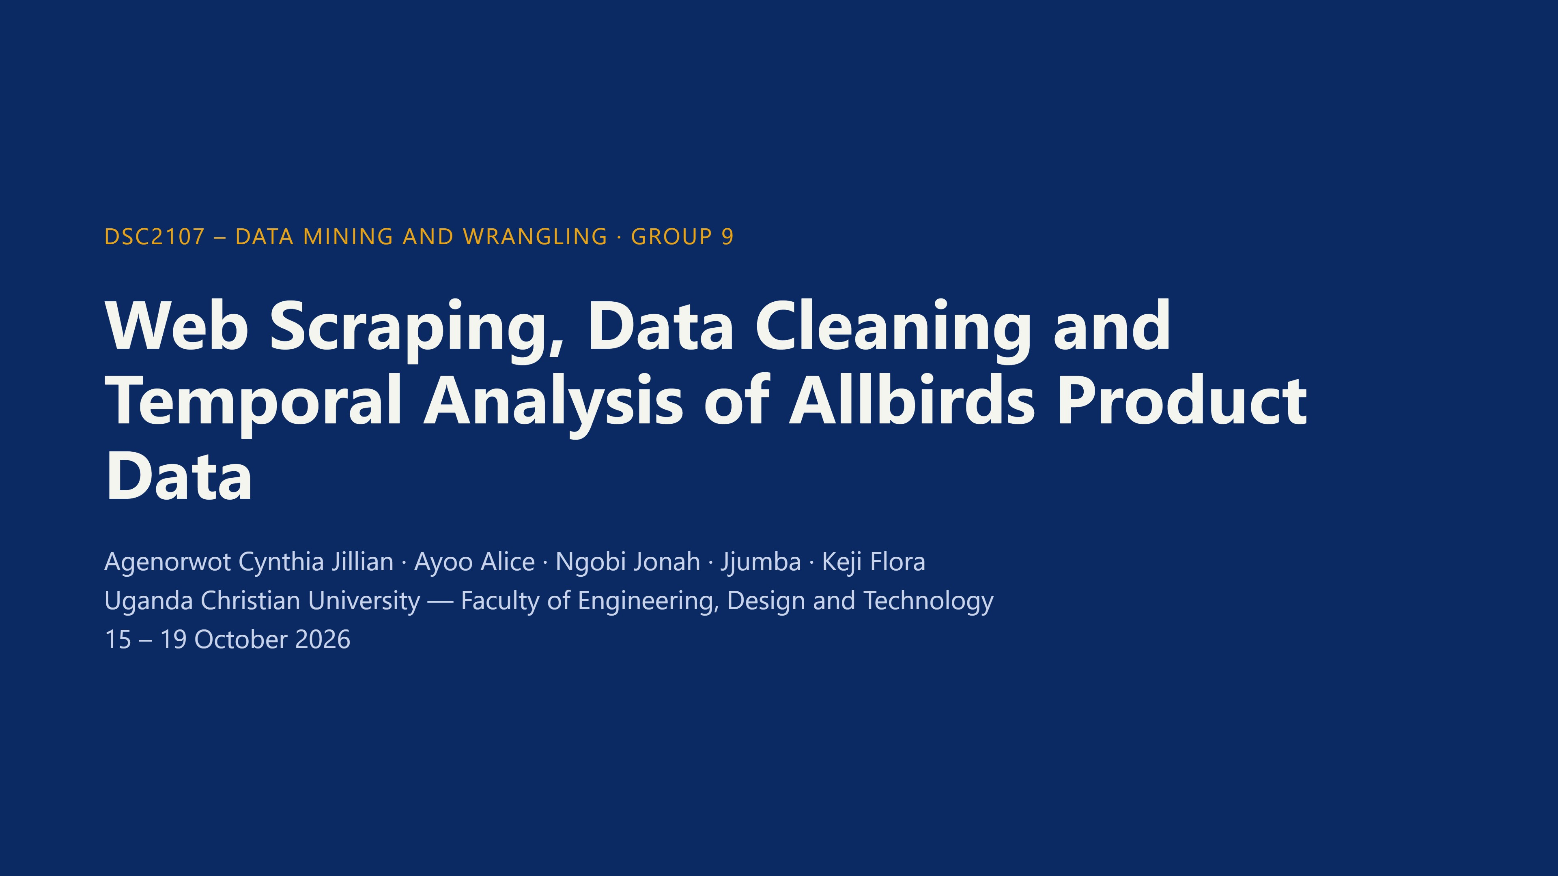
Notes:
Introduce the group. We scraped, cleaned, stored and analysed Allbirds product data over five collection dates.

Slide 2
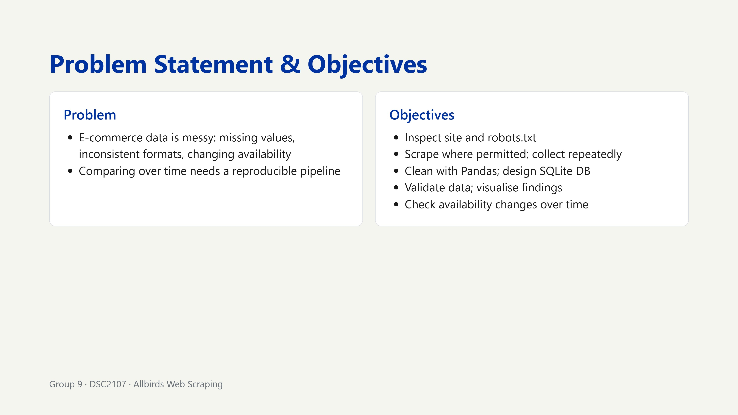
Notes:
We never bypass controls; we respect robots.txt.

Slide 3
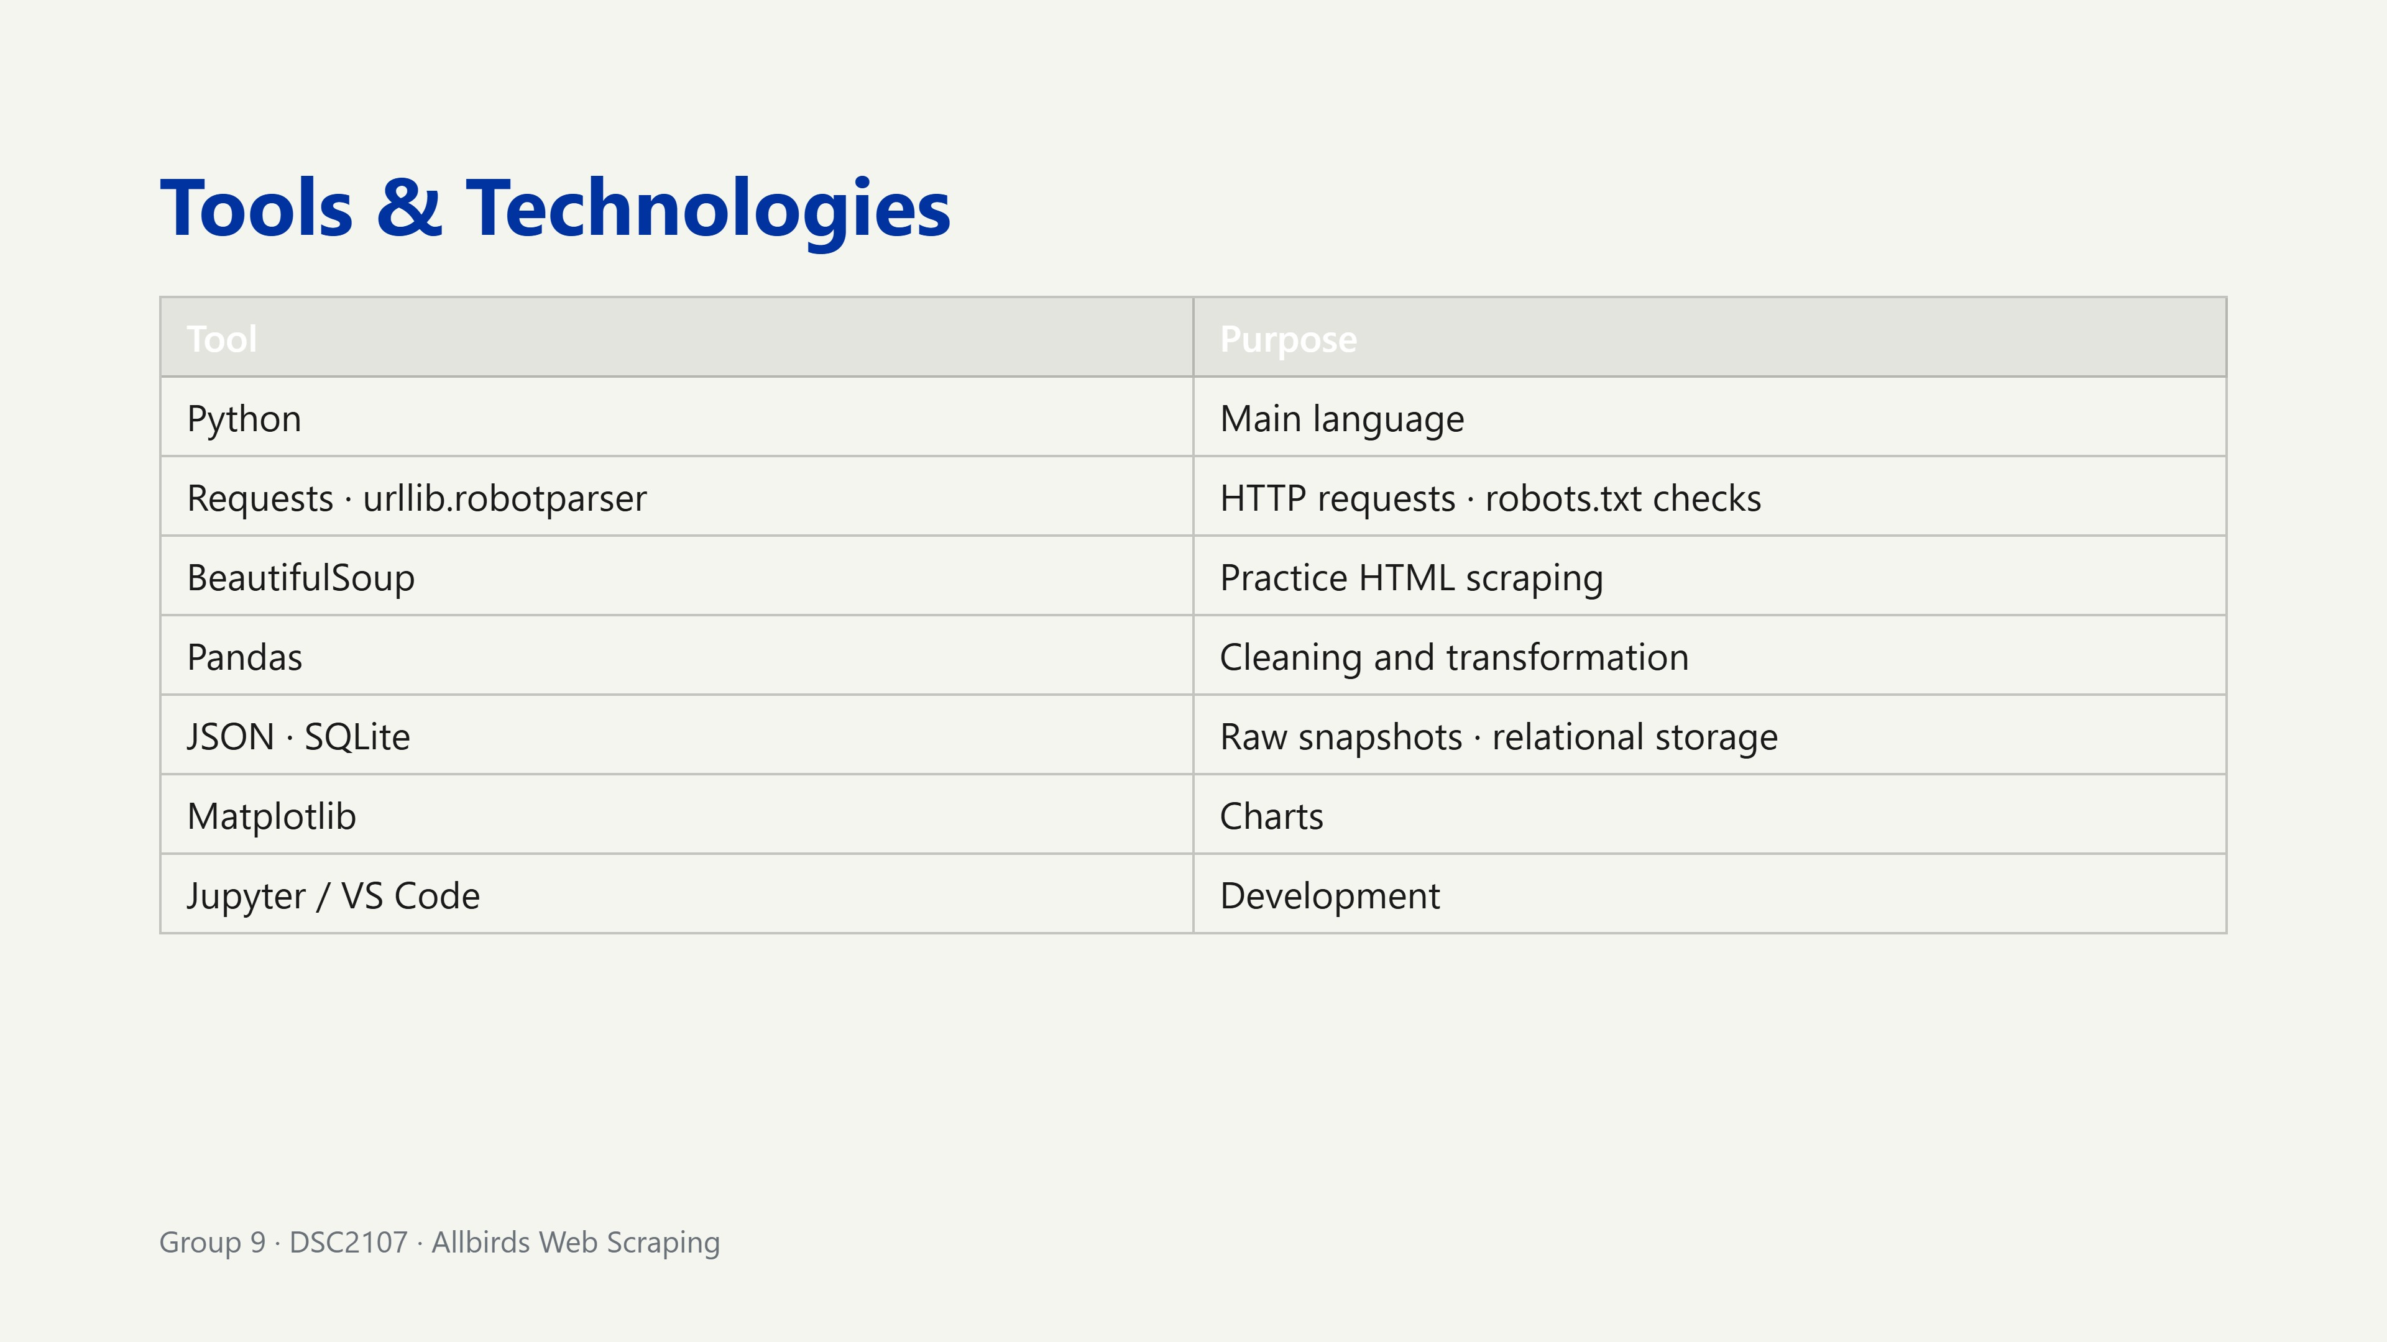
Notes:
Each tool serves one stage of the pipeline.

Slide 4
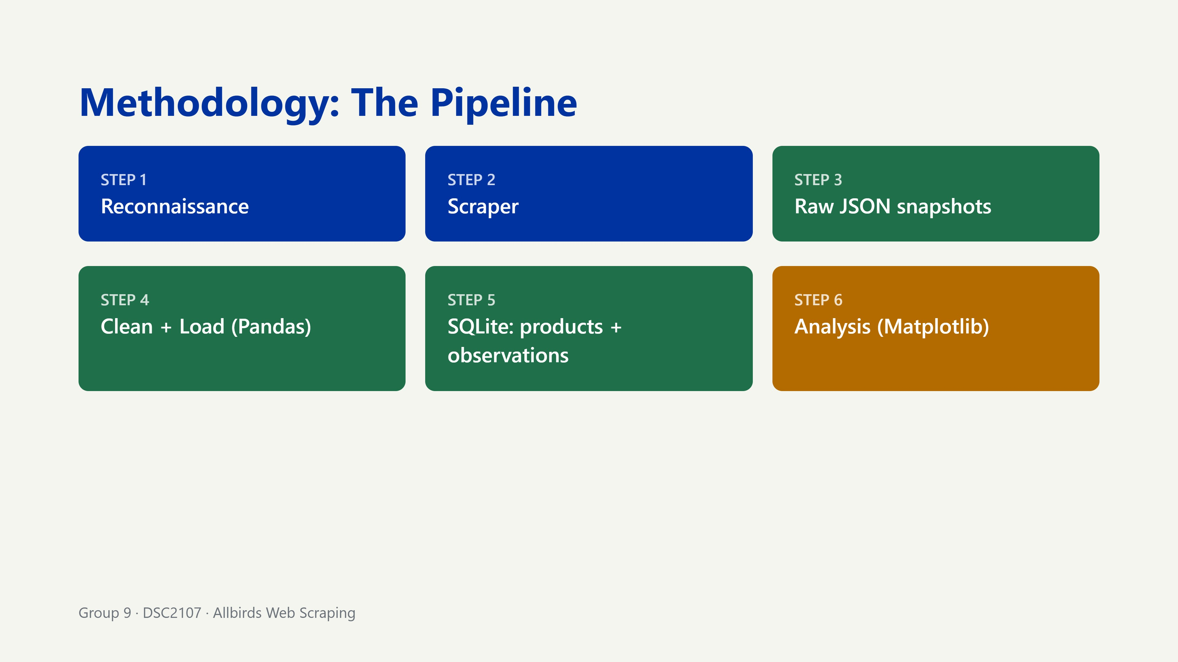
Notes:
Walk left to right, top to bottom. Reconnaissance came first: robots.txt before anything else.

Slide 5
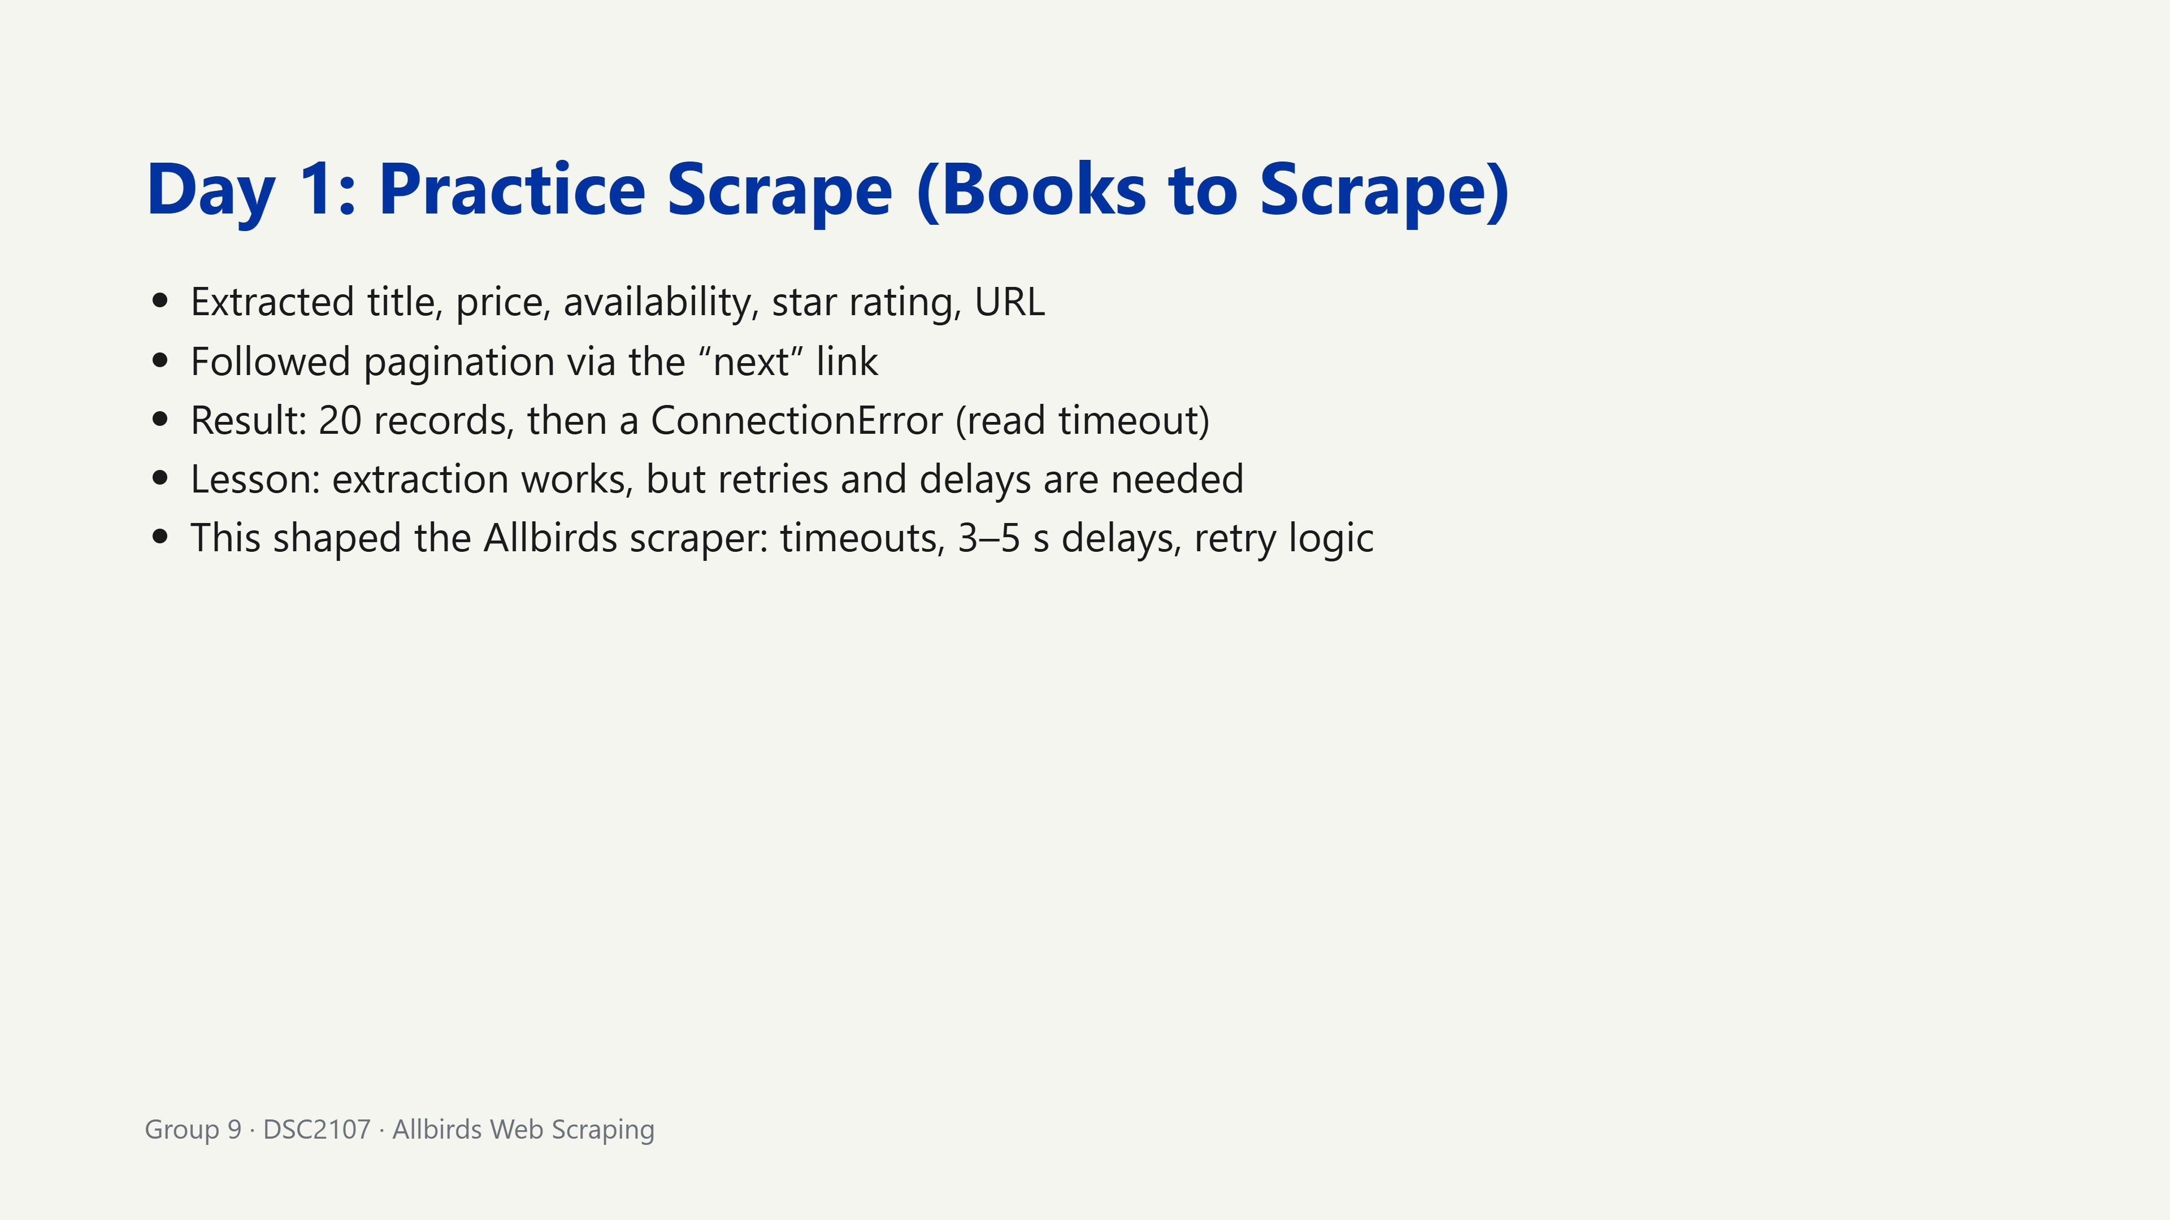
Notes:
The failure was useful: it taught us to build retry handling first.

Slide 6
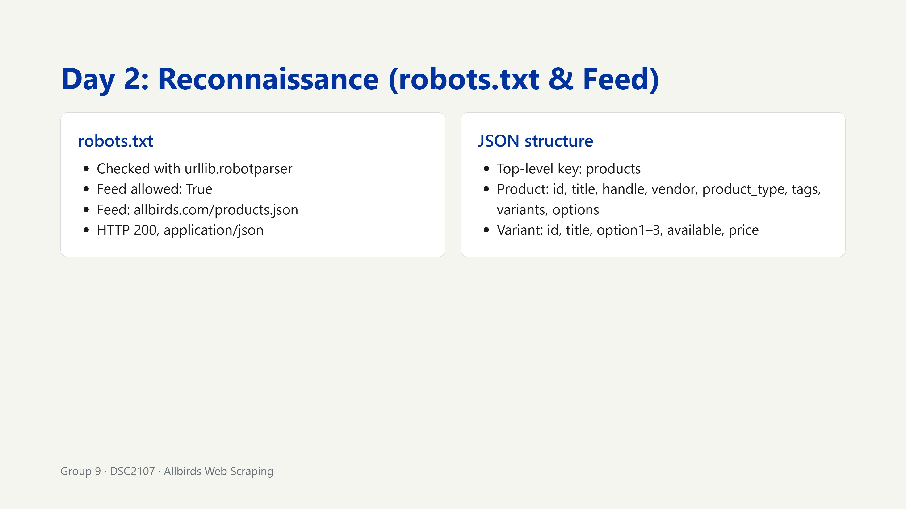
Notes:
We confirmed permission before scraping: the ethical foundation of the project.

Slide 7
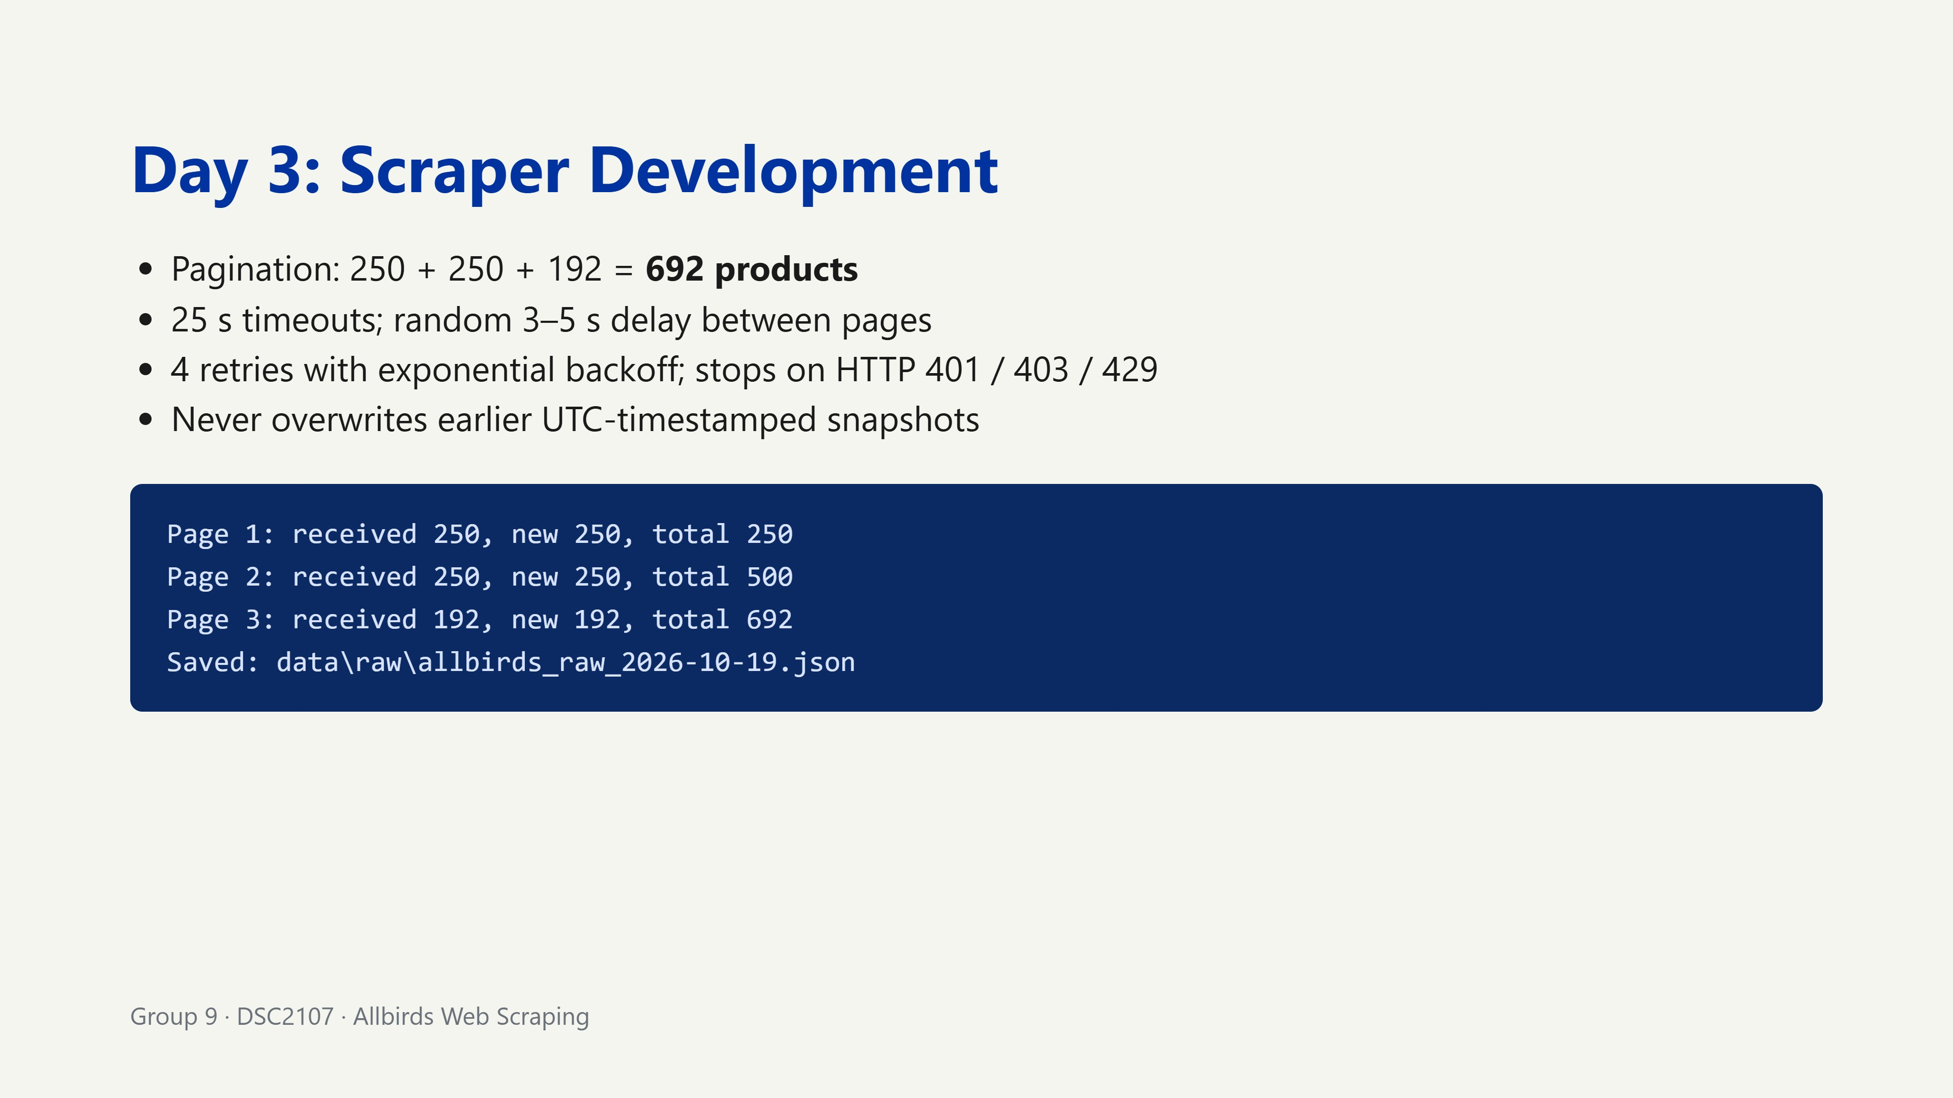
Notes:
Safety features protect both the site and the integrity of our data.

Slide 8
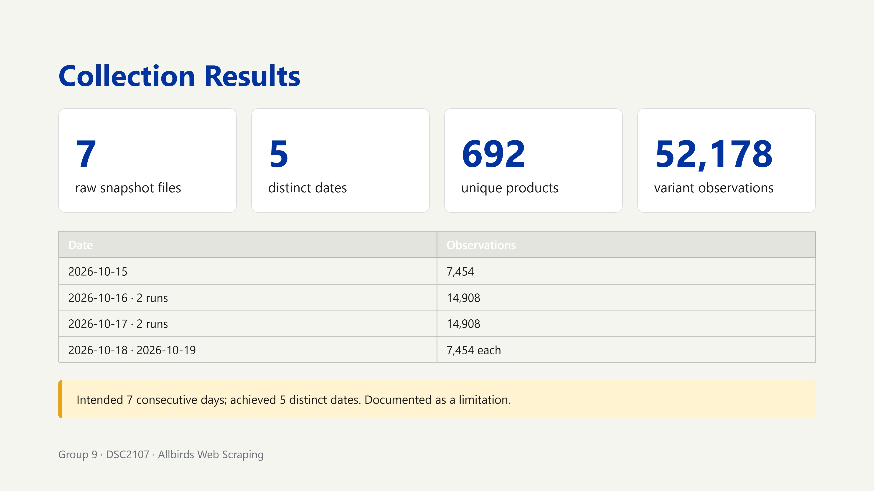
Notes:
Be honest about 5 versus 7 days: academic integrity.

Slide 9
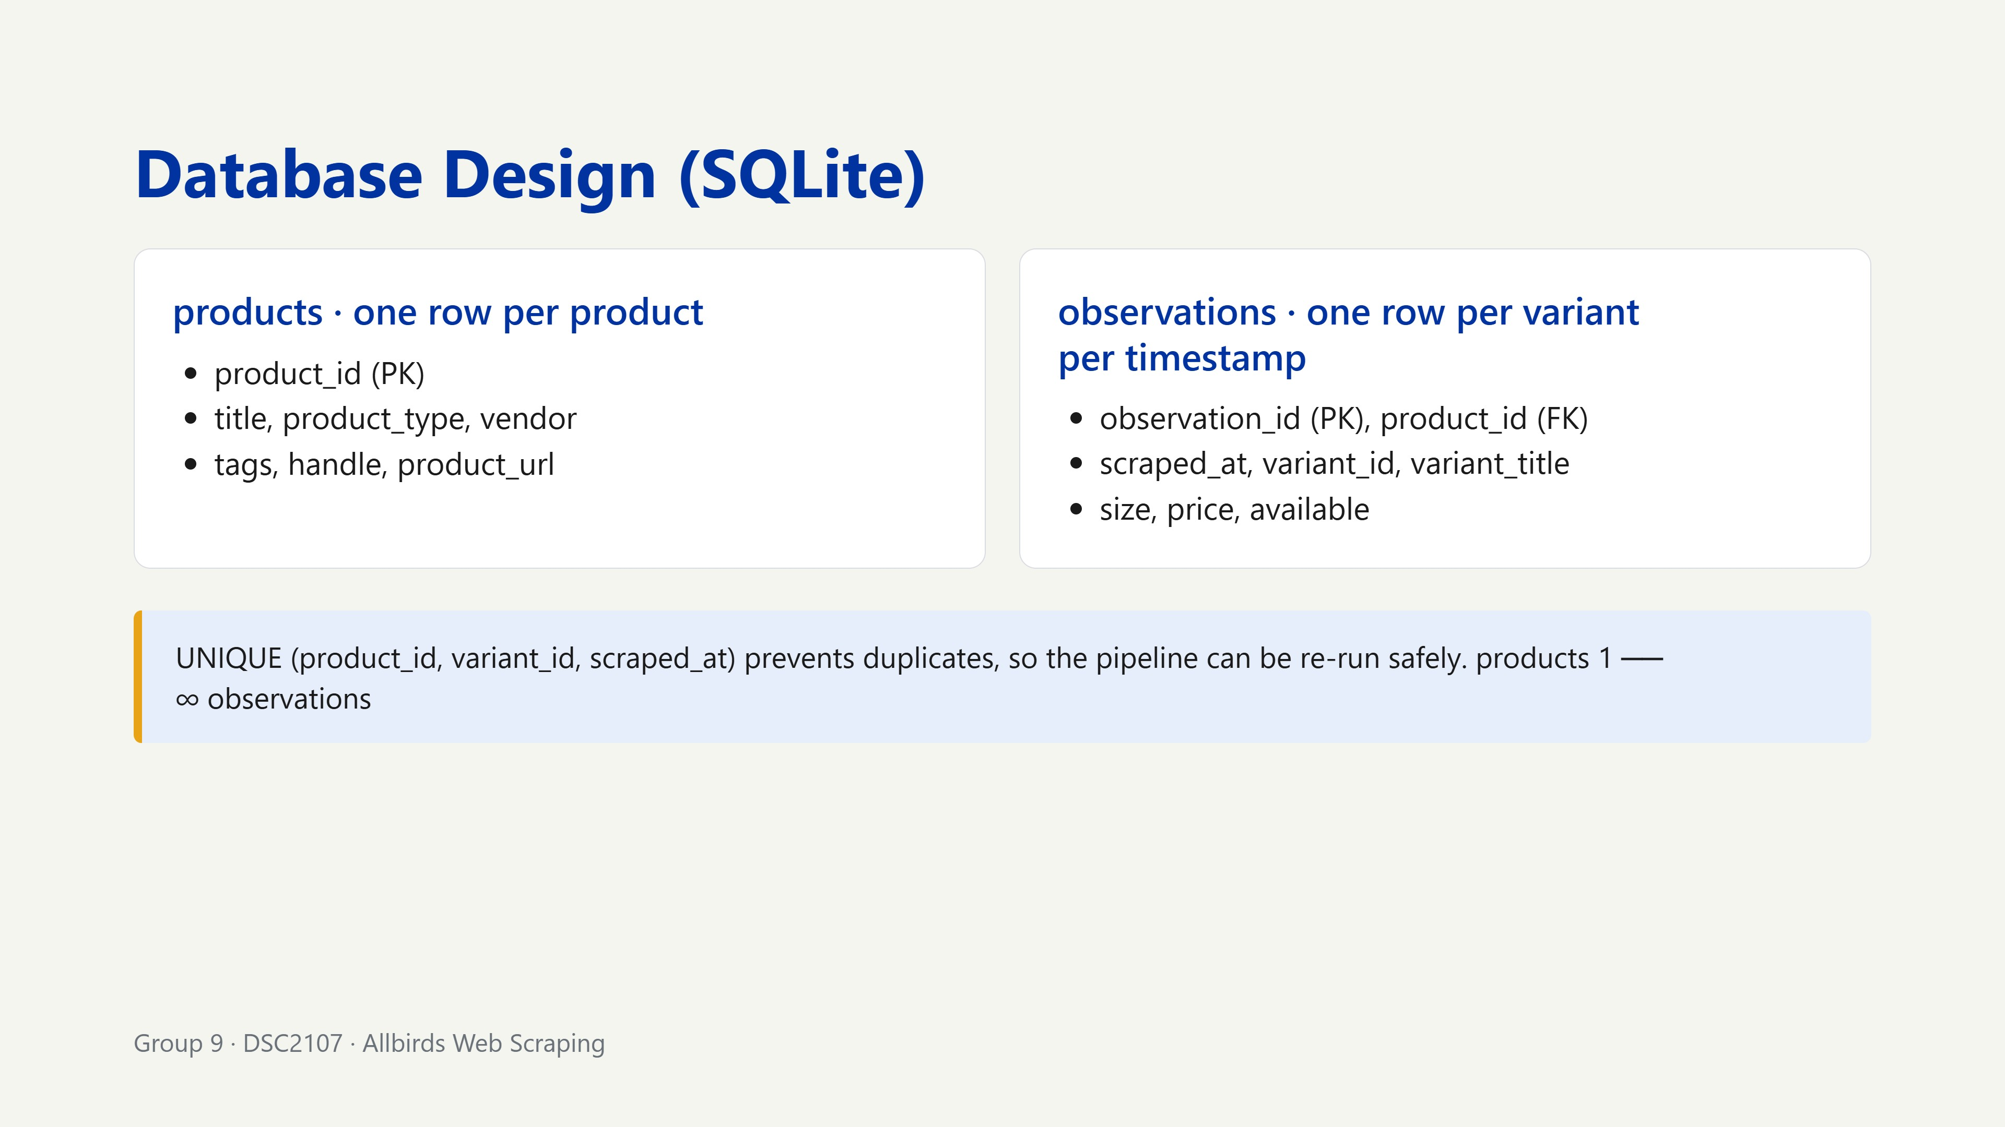
Notes:
The unique constraint lets us re-run the pipeline without duplicating observations.

Slide 10
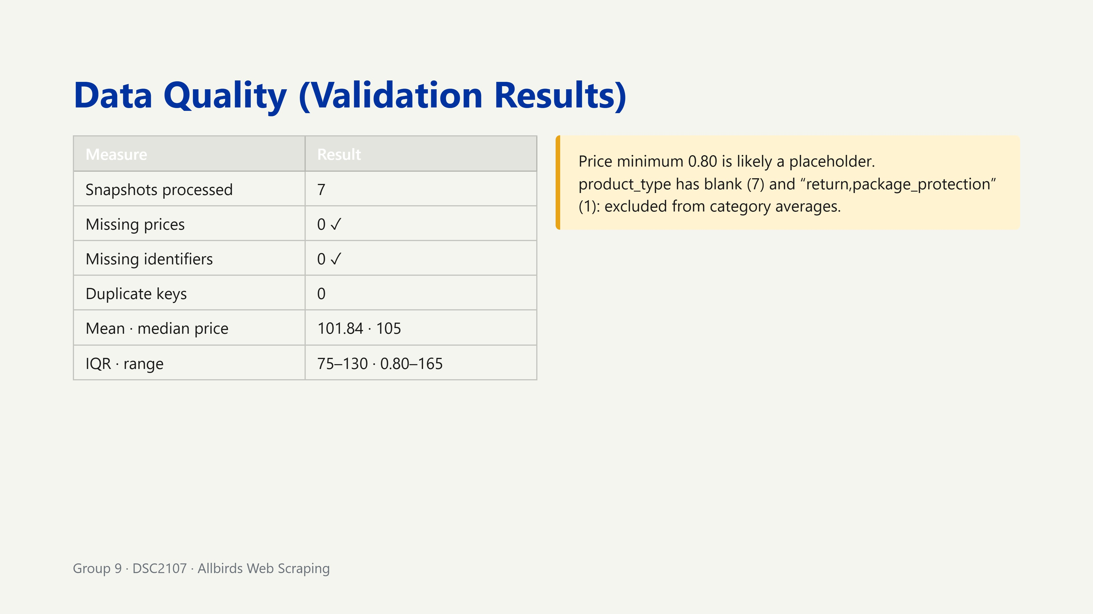
Notes:
Zero missing prices and identifiers, but flag the 0.80 minimum and odd product types.

Slide 11
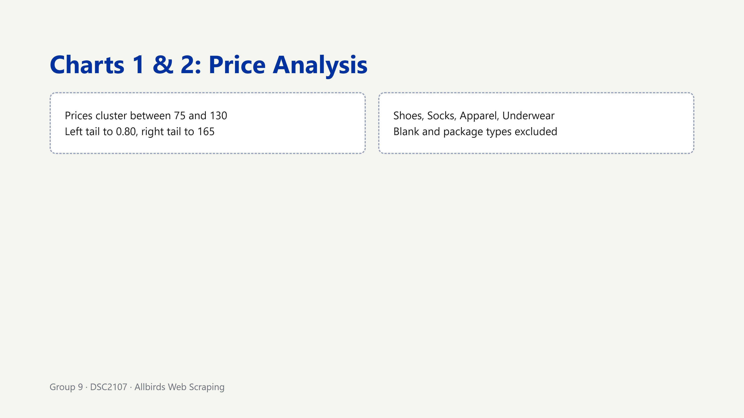
Notes:
Median is 105; the mean of 101.84 is pulled down by the 0.80 minimum.

Slide 12
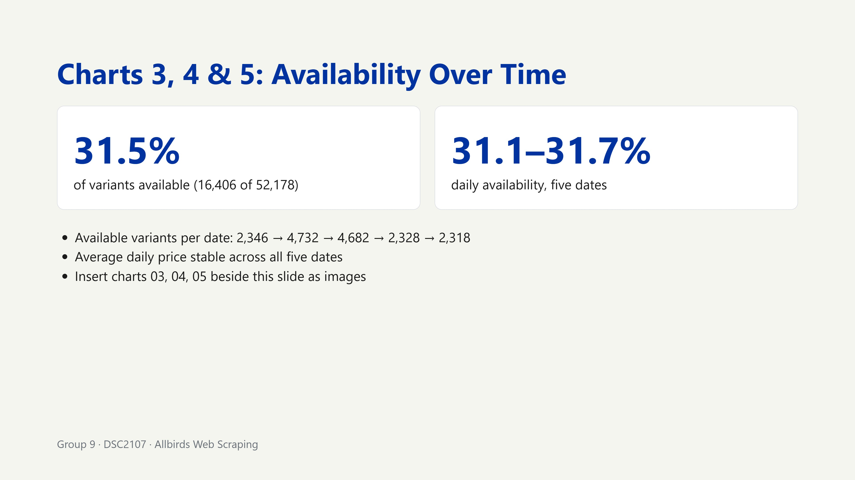
Notes:
Availability barely moved: short-term stability.

Slide 13
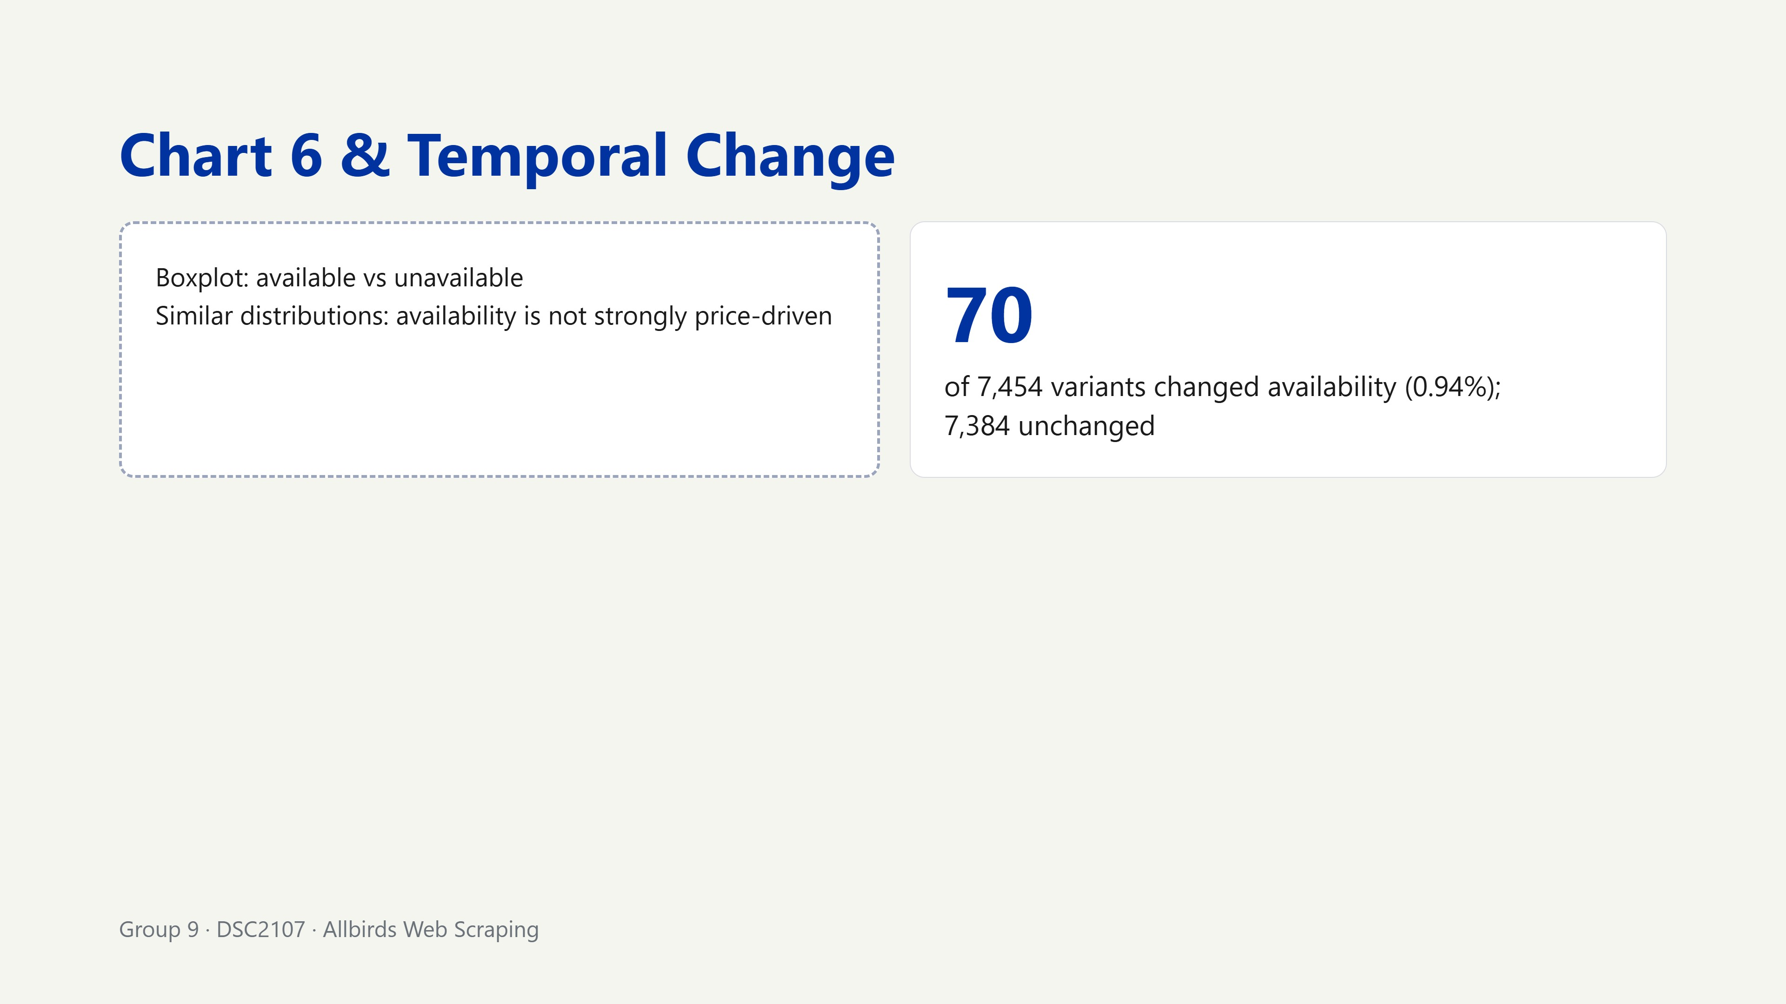
Notes:
A small but real signal. Long-term trends need more days.

Slide 14
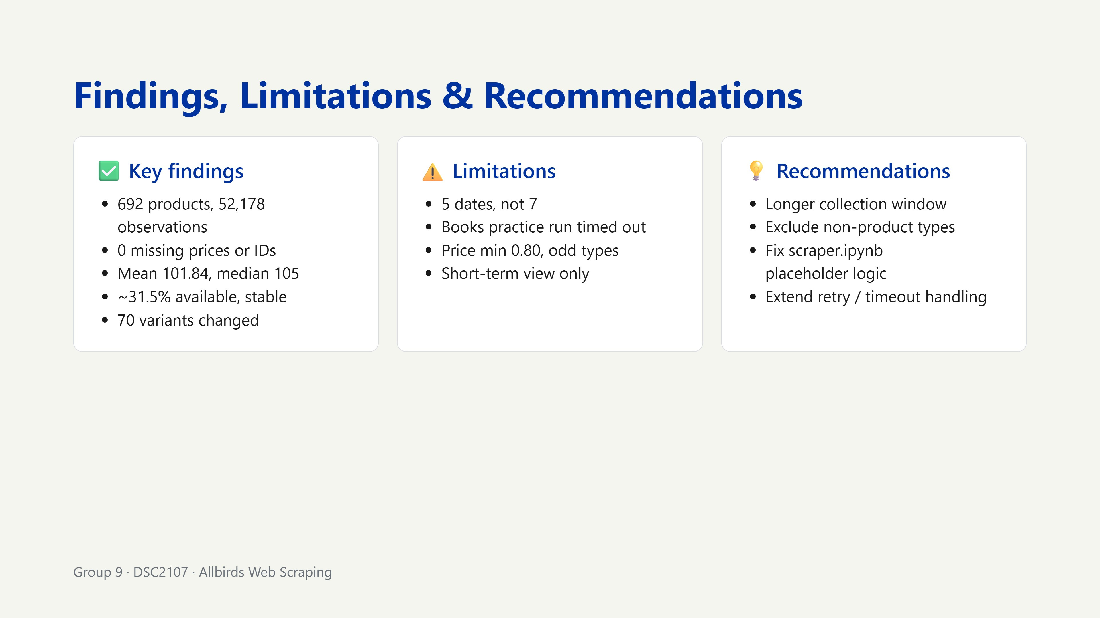
Notes:
End on recommendations: it shows critical thinking.

Slide 15
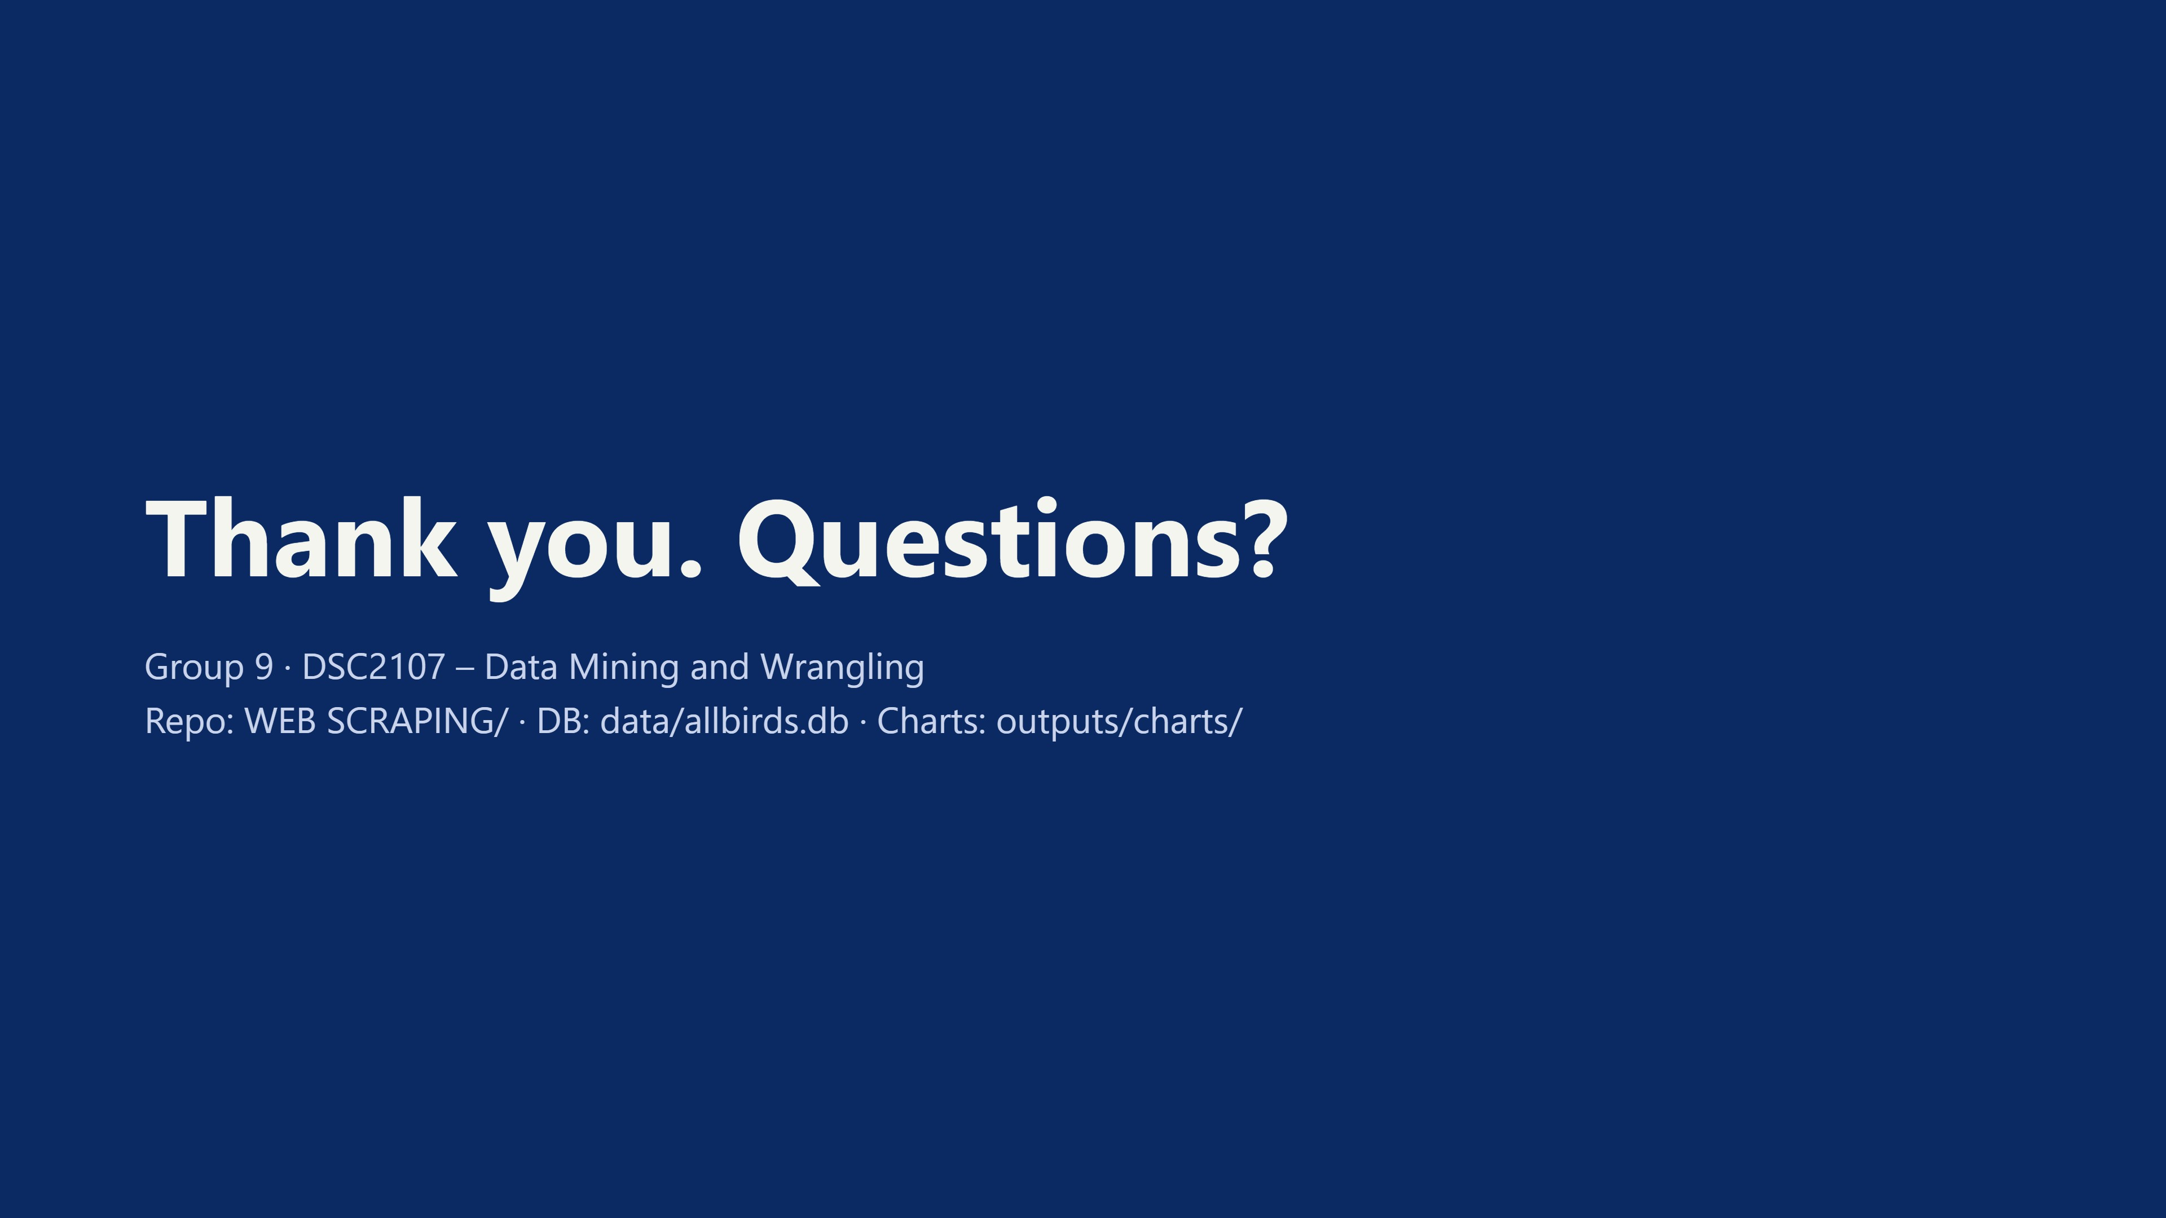
Notes:
Keep the DB and charts open in tabs to show live if asked.

